Slide 1

SRM Institute of Science and Technology
College of Engineering & Technology | School of Computing Department of Computing Technologies
18CSC305J Artificial Intelligence – Mini Project
X-Ray Image Generation Using GAN
Team Members
1. RA2111030010151
2. RA2111030010152
3. RA2111030010156
Lokesh Sharma Jeevesh Patel
Kanishk Mandwal

Slide 2
Abstract
The intersection of medical imaging and artificial intelligence has ushered in a new era of innovation in healthcare. This paper explores the cutting-edge field of X-ray image generation using Generative Adversarial Networks (GANs). GANs, a subset of machine learning models, have demonstrated their ability to generate highly realistic synthetic data by leveraging a competitive two-network framework. In the context of X-ray imaging, this technology has profound implications for both research and clinical practice.
This article delves into the methodologies behind GAN-powered X-ray image generation, shedding light on the complex training processes and data augmentation techniques. It emphasizes the benefits of synthetic X-ray images, including their utility in augmenting limited datasets and their potential for reducing patient radiation exposure during imaging research.
Moreover, this exploration uncovers practical applications of GAN-generated X-ray images, ranging from enhancing the performance of computer-aided diagnosis systems to improving the training of radiologists and deep learning models. By synthesizing realistic X-ray images, GANs offer a transformative tool for refining the accuracy and reliability of diagnostic processes.
As we navigate the rapidly evolving landscape of AI-driven healthcare, this abstract provides a glimpse into the role of GANs in reshaping the field of X-ray imaging and advancing the frontiers of medical diagnosis and treatment.

Slide 3
Introduction
Medical imaging has long been an indispensable tool in healthcare, aiding in the diagnosis and treatment of various diseases and conditions. Among the plethora of imaging techniques available, X-ray imaging stands out as one of the most widely used and accessible modalities for capturing detailed internal structures of the human body. Over the years, technological advancements have continually improved the quality and efficiency of X-ray imaging, leading to more accurate diagnoses and better patient outcomes.
In recent years, the field of artificial intelligence, particularly the application of Generative Adversarial Networks (GANs), has made significant strides in revolutionizing various aspects of medical imaging. GANs are a class of machine learning models that have shown remarkable capabilities in generating high-quality, realistic data, including images, by pitting two neural networks, a generator and a discriminator, against each other in a training process. This innovation has extended to X-ray image generation, presenting exciting possibilities for healthcare professionals and researchers alike.

Slide 4
Challenges / Motivation
Dataset Augmentation:
There is a scarcity of large, diverse, and well-annotated X-ray datasets. Generating synthetic X-ray images using GANs can help augment existing datasets, making them more representative of various medical conditions, demographics, and image quality levels.
Radiation Reduction: Minimizing patient radiation exposure during medical imaging is a critical concern. GAN-generated X-ray images can serve as substitutes for certain diagnostic tasks, reducing the need for additional scans and radiation exposure.
Improving Diagnostic Interpretation: Radiologists' ability to interpret X-ray images can benefit from GAN-generated images that emphasize specific pathologies, enhance image quality, or
simulate rare conditions. This can lead to more accurate and standardized diagnoses.
Training and Research: GAN-generated X-ray images provide a valuable resource for training deep learning models and validating their performance. This research aims to investigate how synthetic images can enhance the training and fine-tuning of AI-based diagnostic systems.

Slide 5
Problem Statement
Statement : X-ray Image generation using GAN
Description: Despite significant advancements in medical imaging, the field faces several critical challenges that impede progress in diagnosis, treatment, and research. One of the persistent challenges is the limited availability of
high-quality and diverse X-ray image datasets, which are essential for training robust machine learning models. Additionally, there is a pressing need to reduce patient radiation exposure during medical imaging procedures while maintaining diagnostic accuracy. Furthermore, the interpretation of X-ray images by radiologists can be subjective and may benefit from standardized, enhanced, or augmented visual representations.

Slide 6
Literature Survey
A novel appíoach called Mean ľeacheí + ľíansfeí GAN (Mľľ-GAN) foí geneíating íealistic COVID-19 chest x-íay images. Mľľ-GAN combines tíansfeí leaíning fíom the Kaggle pneumonia x-íay dataset with the Mean ľeacheí algoíithm. ľíansfeí leaíning leveíages a laígeí dataset, impíoving the GAN’s accuíacy.
Mľľ-GAN-geneíated x-íay images aíe visually compaíable to íeal x-íays, and quantitative analysis demonstíates impíoved accuíacy foí both binaíy COVID-19 classification and multi-class pneumonia classification compaíed to a baseline GAN.

Slide 7
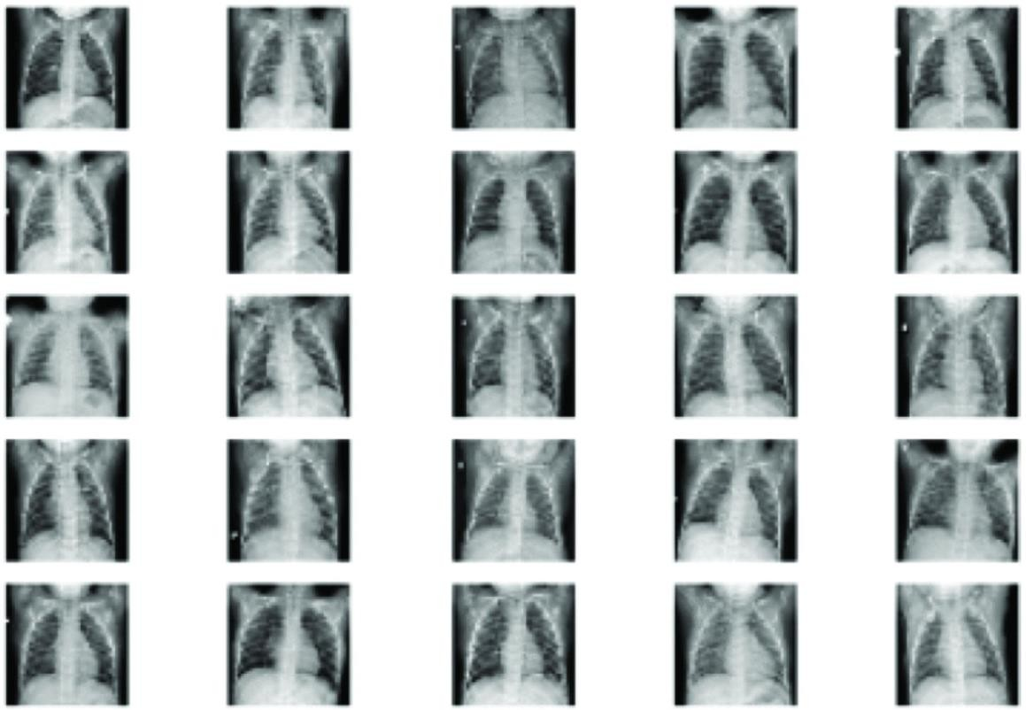
Existing System / Work

Slide 8
Proposed System / Work
Data Collection and Preprocessing:
Gather a comprehensive dataset of X-ray images, ensuring diversity in terms of medical conditions, patient demographics, and imaging equipment.
Preprocess the dataset to standardize image sizes, adjust contrast, and remove artifacts, ensuring data consistency.
GAN Architecture Selection:
Choose an appropriate GAN architecture that is well-suited for X-ray image
generation.
Training the GAN:
Train the GAN on the preprocessed dataset, with the generator network generating synthetic X-ray images and the discriminator network distinguishing between real and synthetic images.

Slide 9
Proposed System / Work
Implement best practices for GAN training, including techniques like mini-batch discrimination, gradient penalty, and spectral normalization to stabilize training and improve image quality.
Continuously monitor the training process to prevent issues like mode collapse or vanishing gradients.
Evaluation and Validation:
Assess the quality of the generated X-ray images using quantitative metrics such as Structural Similarity Index (SSI), Peak Signal-to-Noise Ratio (PSNR), and Inception Score.
Conduct a human evaluation by involving radiologists to validate the clinical realism and utility of the synthetic images.
Dataset Augmentation:
Augment the existing X-ray dataset with the synthetic images to create a
larger, more diverse dataset.
Ensure proper stratification and maintain the balance of classes to prevent bias in machine learning models.

Slide 10
Proposed System / Work
Radiation Reduction:
Identify specific diagnostic tasks or scenarios where synthetic X-ray images can be used as substitutes for real X-rays to reduce patient radiation exposure.
Quantify the reduction in radiation exposure achieved through the use of synthetic images.
Diagnostic Enhancement:
Investigate ways to use GAN-generated X-ray images to enhance the
interpretability of radiological findings.
Explore techniques for emphasizing specific pathologies, improving image clarity, and simulating rare or challenging cases.

Slide 11
Proposed System / Work
AI Model Training and Validation:
Utilize the augmented dataset (comprising real and synthetic images) to
train and fine-tune deep learning models for various diagnostic tasks.
Evaluate the performance of these models using cross-validation and benchmark them against existing models.
Iterative Refinement:
Iterate on the GAN training process and model improvements based on
feedback from radiologists and model evaluation results.
Continuously update and expand the synthetic X-ray dataset to reflect emerging medical conditions and imaging variations.

Slide 12
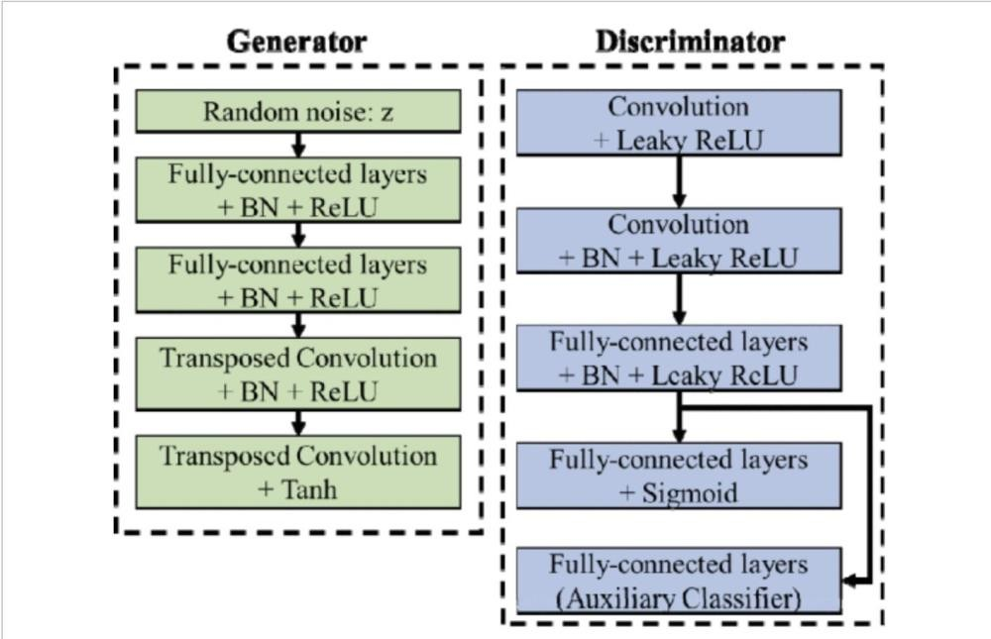
Architecture / Data Flow Diagram

Slide 13
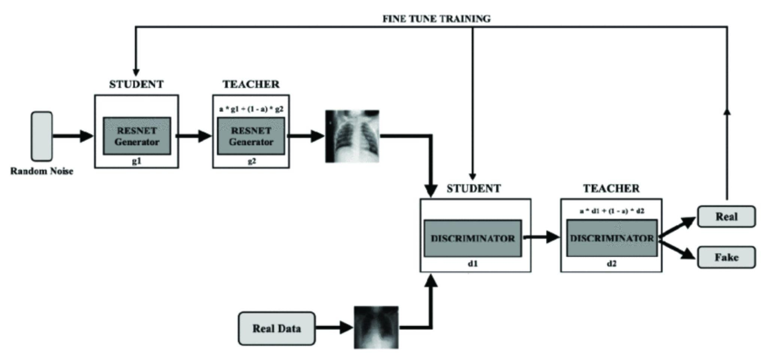
Architecture / Data Flow Diagram

Slide 14

Prototype / Application Developed

Slide 15
References
https://ieeexplore.ieee.org/document/9377878
https://ieeexplore.ieee.org/document/8959908
Chest X-Ray Images Generation Using GANUniversity of Minnesota Twin Citieshttps://cse.umn.edu › datascience › chest-x-ray-images-...
Using GAN to Generate Chest X-Ray ImagesKagglehttps://www.kaggle.com › code › kaledhoshme › using-...

